Slide 1
IN HOT PURSUIT RETHINKING COURSE OPTIONS

Slide 2
Introductions
Bruce Bingman – National Race Officer & Chair US Sailing PHRF Committee; PRO Blue Circle, STC Block Island Race Week and PRO Annapolis to Newport Race
Chris Museler – YRA Representative, Long Island, PRO The Archipelago Rally
Nathan Titcomb – Offshore Director, US Sailing
Special thanks to Jeff Johnson, Tom Duggan and Taran Teague for sharing their experiences to improve the presentation

Slide 3
The Old Days

Slide 4
Fast Forward 100 Years!

Slide 5
No More Windward-Leeward!
Racing participation is dropping in almost every venue – except:
Casual Wednesday nights around Government buoys
Pursuit racing catering to newcomers and cruisers
Non-traditional Windward-Leeward courses
Point to Point destination racing
Looking around the boatyards there are an increasing number of “Performance Cruisers” replacing traditional racing boats
Sailors are telling us with their feet what they want!

Slide 6
Course Options Beyond Windward-Leeward
Drop Mark Options
Modified Olympic
Harry “A”
Government Mark Options
Closed Course
Open Course
“Random” Race
Point to Point

Slide 7
Starting Options
Pursuit Starts
“Le Mans” Starts
Rally Races
Downwind or Reaching Starts
Conventional Starts

Slide 8
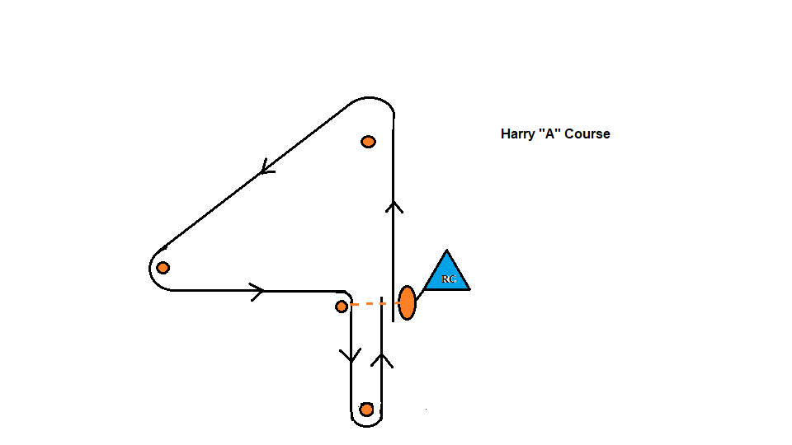
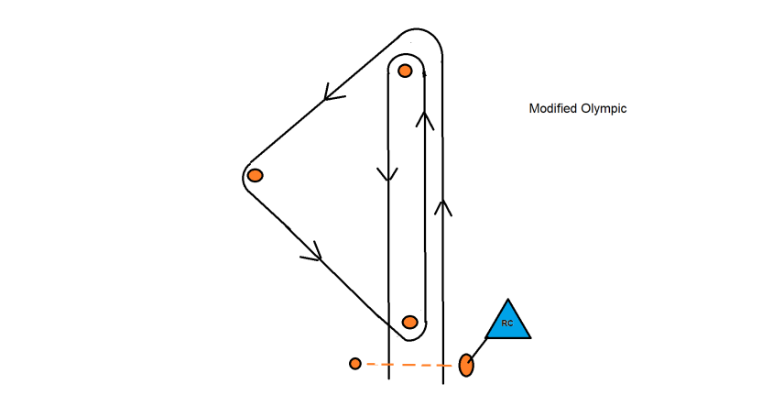
Let’s Talk About Some of These Options
Modified Olympic and Harry “A” Courses
Offer reaching legs
More passing lanes for handicap boats
Still requires mark boats and skill in setting course
Popular with racers and “serious” cruisers - not so good for the novice or first time sailors

Slide 9
Government Mark Options
Easy to run – typically need only a committee boat
Start and finish same place (Closed Course)
Start in open water and finish at ? (Club, Party Site, Cruising Destination, Etc.)
Offers all points of sail - May have “offwind” start
May require some “blue water” navigation
Popular with cruisers and casual racers
“Random” race has fixed start/finish and gives a list of buoys to round – racers pick their own course!

Slide 10
Government Mark Options (Cont.)
A few things to remember:
Government marks are used to mark channels – be aware of regulations in your area about commercial traffic and “clear lanes”
May need USCG permit to run
Should provide verbiage in SI’s to remain well clear of commercial traffic

Slide 11
Point to Point Options
“Destination” races have been very successful
Typically big party at the finish
Have proven to be popular with both racers and cruisers
Some of the biggest races in the country with hundreds of participants:
FIGAWI
Chesapeake Bay Governor’s Cup
Delta Ditch Run

Slide 12
Starting Options
Pursuit Start
Boats wait until their handicap is expired, then start – thus slower boats start first, faster boats last
Reduces or eliminates the stress of starting with many other competitors and complexity of start rules
Very popular with cruisers and sailors new to racing
Small boats love being in the “clear” and love to see the big guys behind – running aground, etc. - big boats love to pass little boats
Keeps it fun for all

Slide 13
Starting Options (Cont.)
“Le Mans” start
Boats are anchored with all sails down behind start line
All crew below – or a variant, crews aboard, skippers on shore and must row dinghy to boat after start signal
Popular with cruisers but best for smaller fleets
Downwind or reaching start
May be only option for Point to Point Race
Must be careful to “bias” line to prevent “pile up” at one end or the other
Good for “Pursuit” start – cruisers like!

Slide 14
Starting Options (Cont.)
Rally Race
Boats sail to a predetermined time for the race. The boat closest to the predetermined time wins
Set times based on time median boat will sail the preset course (use experience, US Sailing Velocity predictions or Designer’s prediction). Adjust all other boat times relative to median boat using PHRF handicaps and race distance. Add 20% to each time and allow 5 minutes of engine time.
Start boats off at 30 second or one minute intervals, slowest first.
Great fun to see boats stalling or motor sailing flat out at finish to try to hit exact time!

Slide 15
How do you set up a pursuit race?
Several of the available scoring programs offer pursuit race options that will pre-calculate start times
Set up your own spreadsheet
Can do in Time on Time but much easier in Time on Distance scoring
Use the “TIME” function in Excel with all references in hh, mm, ss functions to calculate start times
Expression for start time is:
First Start + (TIME(0,0,(reference rating – competitor rating)) x Distance)

Slide 16
Mixed Format Races
Mix distance races with buoy/ drop mark races in multi-day events
Use the same starting line for both distance and drop mark races
Allow for drops or “lay days”, particularly in cruising classes

Slide 17
Have Fun!
The key to participation is to put the “fun factor” back into racing
New or varied formats
Emphasize sailing and destination, not who gets there first
Great parties
Increased Comraderie

Slide 18
SUCCESSES!
Block Island Race Week, the NYYC Annual Regatta and the STC Fall Chesapeake Regatta have used mixed format very successfully with 2 to 4 days of buoy racing plus a distance buoy or “around the island race”
In 2013 and 2015, the Performance Cruiser classes at Block Island Race Week ran from the same start as the traditional W-L classes but only used the windward drop mark as their first mark and sailed a Government buoy course around Block Island Sound after that. This year, based on competitor feedback, the “Navigator” races at BIRW used pursuit starts with “Lay Day” and met with high praise from the competitors. One race days allow time for beach going or sightseeing!

Slide 19
SUCCESSES(cont.)
The last two Annapolis to Newport races featured a “Performance Cruising” class – which is becoming the largest class and was split into two subclasses this year. ,
The FIGWI is the “granddaddy” of all pursuit racing and typically has nearly 300 entries
The HOT Rum Race in San Diego mixes Pursuit start, tricky tides and the overall mantra of “have fun racing and make friends afterwards” into the most successful race on the West Coast

Slide 20
Let’s look at a successful alternative format race in detail: The Archipelago Rally

Slide 21
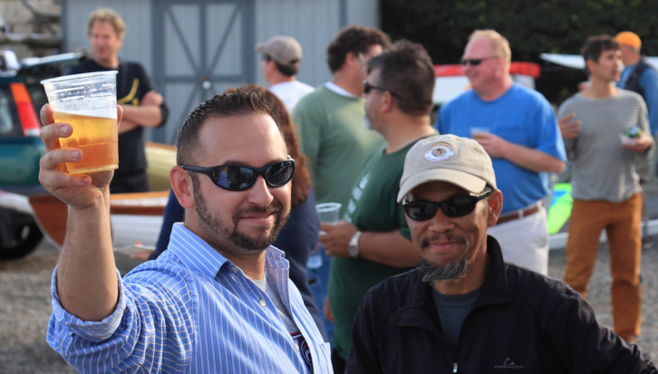
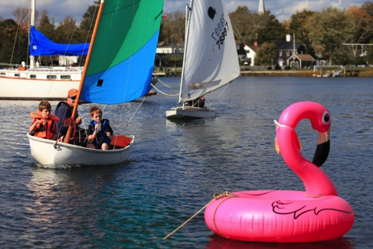
The Archipelago Rally Evolution-Format-Execution

Slide 22
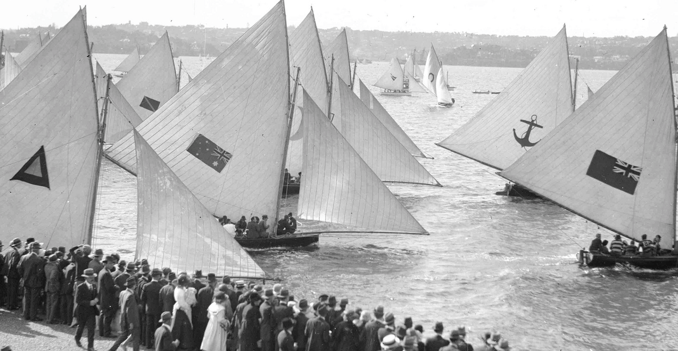
PURSUIT STYLE
“Took their Handicap at the beginning for the start.”
Early 1900s:
AUSSIE 18 Foot Skiffs

Slide 23
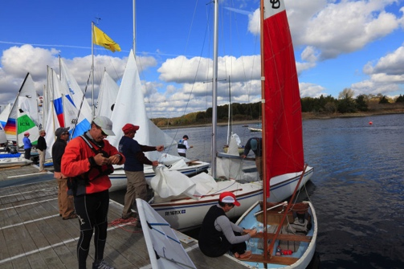
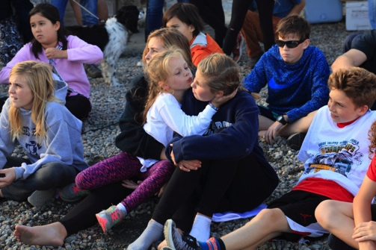
Addictive Work in Progress Collaborative versus Competitive
“Come as you are and we’ll fit you in.”

Slide 24
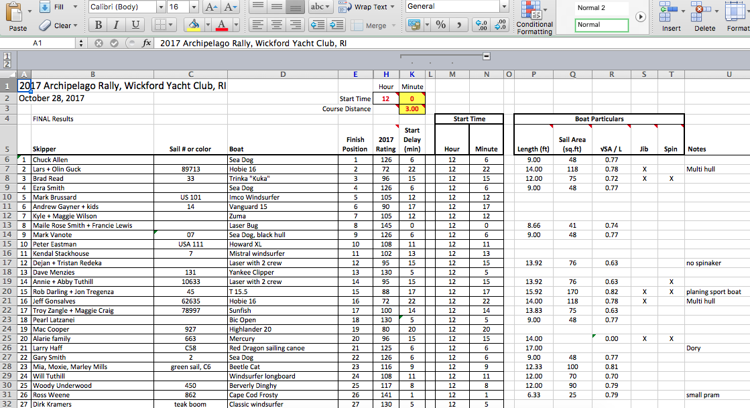
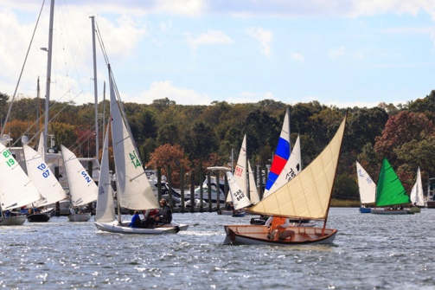
HOW it works!
- No entry fee
- Volunteered food
- E-vite
- Portsmouth Yardstick modified
- Adventure and Team Work
Multi-year RACE DATA

Slide 25
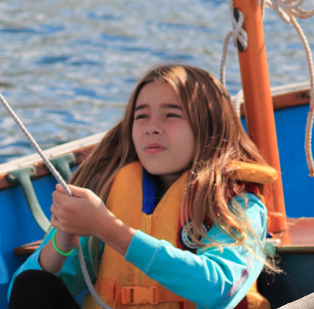
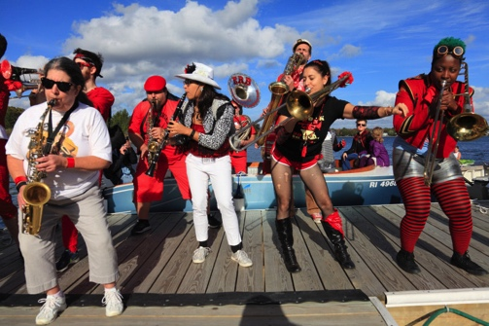
RALLY RECIPE Design for success
- 1.5-hour race or less for slowest boats
- LOTS of time to rig
- Reachy Course
- Add time to ralliers who crush the fleet
- Make PARTY longer than RACE

Slide 26
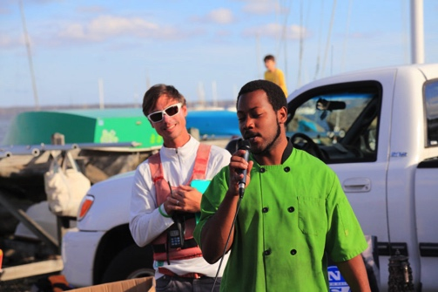
Social Responsibility
“Use your Platform to Help others and Raise Awareness.”
JULIUS from
Food4Good

Slide 27
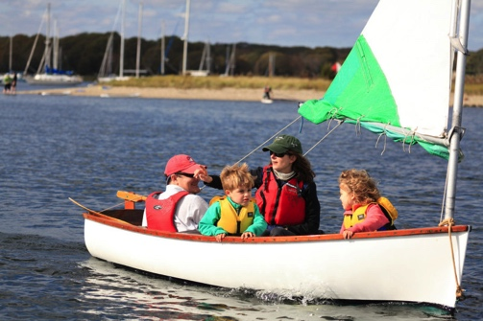
RALLY ON!
NOTE: All images from 2017 Archipelago Rally at Wickford YC by Rufus Van Gruissen

Slide 28
LET’S GO SAILING! ANNAPOLIS – NEWPORT START

Slide 29
Downwind Point to- Point start

Slide 30
Leaving the Great Salt Pond at Block Island

Slide 31
Your Opinion Matters Please open the Sailing Leadership Forum app and complete the session survey found in the menu bar for a chance to win a free drink ticket! Thank you for attending this session

